Slide 1
Scalar Encoder with Buckets
Presented by:
Aqib Javed Matriculation No. # 1427145

Slide 2
OBJECTIVE:
The objective of the paper is to evaluate the limitations of Scalar Encoder and propose a solution by combining it with Buckets Without Buckets concept it is less versatile, Limited Precision and Lack of adaptability. This paper evaluates the limitations of the Scalar Encoder and how they can be addressed by combining the Scalar Encoder with Buckets.
By introducing the concept of Buckets, the paper seeks to provide a more precise and efficient method for encoding data, particularly in scenarios where periodic encoding of values is needed. Overall, the objective of the paper is to enhance the performance and accuracy of Scalar Encoder in real-world applications, particularly in sensor data analysis.

Slide 3
TABLE OF CONTENTS
Introduction
Methodology
Implementation of Buckets
Results
Conclusion

Slide 4
Introduction:
Scalar value encoding is a fundamental operation in machine learning, used in a wide range of applications.
The technique involves HTM, SDR, Encoder and Scaler Encoder.
The encoding with bucket method is a significant improvement over traditional scalar encoding methods, providing increased accuracy and flexibility for a wide range of machine learning tasks.

Slide 5
Hierarchical Temporal Memory (HTM):
It is used to model the structure and function of the neocortex, the part of the brain responsible for perception, learning, and intelligent behavior.
HTM can be used in various applications such as anomaly detection, natural language processing, and image recognition.
HTM can also be used in image recognition, where it can learn the features and patterns of images and recognize them in real-time.
Example of HTM application is in natural language processing. HTM can be used to model the structure and function of the language regions of the human brain and help to understand the context and meaning of natural language.
SDR:
SDR is often used in anomaly detection tasks because it can represent patterns of data in a way that is both sparse and distributed.
SDR can be used to represent the meaning of words and phrases in a way that is both efficient and effective.
SDR can be used in brain-computer interface systems to decode neural signals and convert them into actionable information.
Example of SDR is its use in natural language processing. In this application, each word is represented by an SDR, which allows for efficient and robust computation of the word's meaning.

Slide 6
Encoder:
Encoders are used to convert raw input data into Sparse Distributed Representations (SDRs).
It can be used to compress data by transforming high-dimensional data into a lower-dimensional representation while retaining most of the original information.
Encoders can be used in combination with decoders to create generative models that can generate new samples from the learned latent space.
Example of an encoder is the auto-encoder, which is a neural network architecture that is used for data compression and feature extraction.
Scalar Encoder:
Scalar encoder can be used to encode continuous time-series data, such as temperature or stock prices, into a sparse distributed representation (SDR).
Scalar encoder can be used to encode numerical data in natural language processing applications, such as sentiment analysis and text classification.
Scalar encoder can be used to encode sensor data from IoT devices, such as temperature, humidity, and light levels, into a sparse distributed representation.

Slide 7
Methodology
Spatial Pooler maps active columns' cells during SDR input creation.
Implementing inhibitory mechanism results in constrained representation of input with similar patterns resulting in similar activation columns.
Learning occurs through synapse persistence updates, with active bits enhancing persistence and inactive columns being boosted to ensure participation in training.
SDR is a sparse information organization system, meaning only a small fraction of the cells are active at any given time.

Slide 8
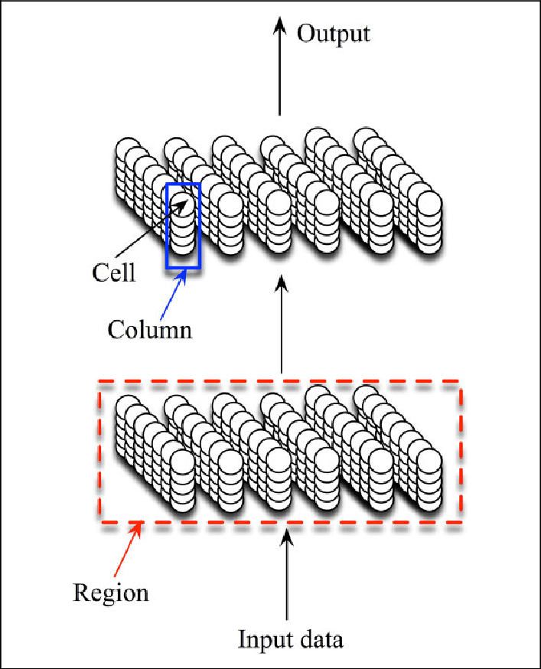
Methodology
Active cells in SDR are distributed throughout the region to represent the region's activity.
The binary representation of SDR in HTM is highly computationally efficient and does not result in a functional loss of information due to critical features of SDR.
Buckets are used to divide a continuous value range into consistently sized intervals.
The width of each bucket is calculated by dividing the range of values by the number of buckets needed.
Fixed-width bucketing is a basic and extensively used scalar encoding technique, although it may not be suitable for data with irregular distribution.

Slide 9
Implementation
Understand the components of data to design an effective encoder.
Divide the value range into buckets and map them to active cells to build the encoder implementation.
A scalar encoder is a device that converts a numeric (floating point) value to a bit array. The output is entirely 0's with the exception of a continuous block of 1's whose placement changes in real time as the input value changes.
The encoder was developed with the aim of mapping continuous scalar data onto a defined range of integers to encode them into sparse distributed representations (SDRs).
The encoder calculates the SDR's bit count and bucket width by first calculating a scaling factor and a resolution.
The scalar encoder with buckets uses a clustering technique to classify similar values into buckets of the same size, making it more effective than a scalar encoder with a set bucket width when dealing with uneven data distributions.

Slide 10
Implementation
BucketMatch Score: Calculates the closeness score of an input value to each bucket range.Returns a list of activation levels for each bucket.
EncodedArray:Maps input values to continuous ranges of buckets instead of individual buckets.Returns an encoded array of activation levels for each bucket.
Decode: Decodes the encoded array back to the original input values.Uses the same parameters as the Decode method.
DetermineBucketIndex: Supports periodic encoding of values. Returns the index of the bucket that an input value belongs to.
MapInputToBuckets: Automatically generates a hierarchy of levels for the bucket ranges based on their size. Returns a list of levels and their corresponding bucket ranges.
RangeDescription: Generates a description of the bucket ranges used to encode the data. Returns a string describing the bucket ranges and their parameters.
ScalarEnocderAnalyzeInfo: Provides information on the parameters used to create the bucket ranges, such as the min and max values and the bucket size. Returns a dictionary of the parameters for each bucket range.
GetBucketValues: Returns the list of bucket values for a given bucket range. Useful for encoding cyclical data with periodic encoding.

Slide 11
Result
From all the testcases carried out in the training phase
Increased Precision: The implementation includes the EncodedArray method that maps input values to continuous ranges of buckets and the BucketMatch Score method that calculates the closeness score, resulting in a more precise encoding of input data compared to the Scalar Encoder.
Improved Flexibility: The Scalar Encoder with Buckets adapts to input data by automatically setting parameters and generates a description of bucket ranges, making it more flexible and user-friendly for different datasets.
Periodic encoding: The implementation section includes the Scalar Encoder with Buckets, which supports periodic encoding of values, generating mappings and returning bucket values for encoding cyclical data..
Improved Encoding Scheme: The Scalar Encoder with Buckets is an enhanced encoding scheme that utilizes continuous ranges of buckets, providing improved efficiency and performance compared to the limited precision and inflexibility of the Scalar Encoder.

Slide 12
CONCLUSION
In conclusion, the Scalar Encoder with Buckets is an improved version of the Scalar Encoder that overcomes some of its limitations. By mapping input values to continuous ranges of buckets, the Scalar Encoder with Buckets provides better precision in encoding data compared to the Scalar Encoder. The automatic setting of parameters such as the number of buckets and bucket size based on the input data, as well as the generation of a bucket range description, increases the flexibility of the Scalar Encoder with Buckets and makes it easier to adapt to different datasets. Furthermore, by supporting periodic encoding of values, the Scalar Encoder with Buckets can handle cyclical data more effectively.

Slide 13
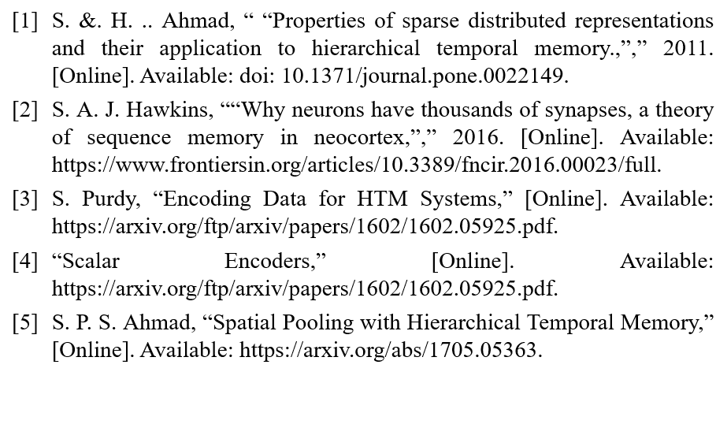
References

Slide 14
Thank you Team_Scalar_Enocder

